Slide 1
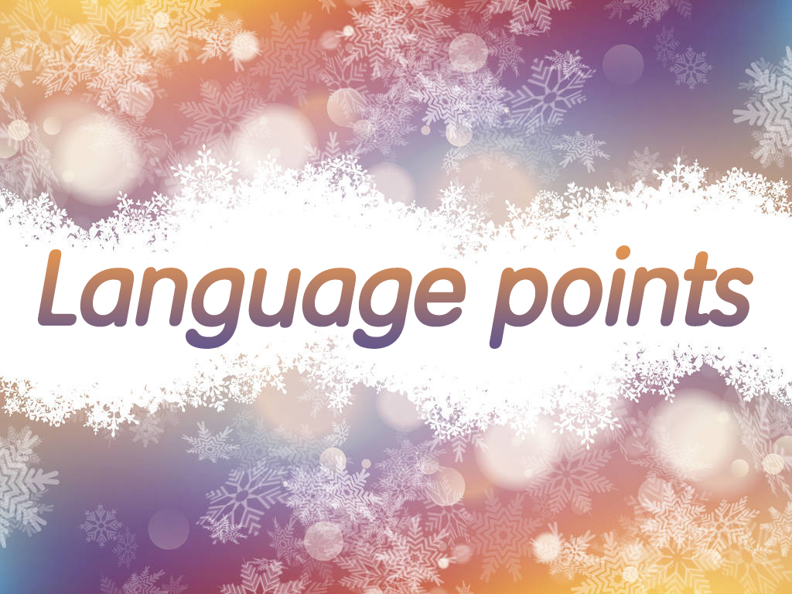

Slide 2

1. Do you often throw away things you
don’t need anymore?
你经常扔掉你不再需要的东西吗？
throw away
1) 扔掉, 抛弃
2) 错过(机会等)，放过；未能很好利用
(机会等)
3) 浪费(时间、金钱等)

Slide 3
【语境应用】翻译下列句子。
1) I never throw anything away.
2) Don’t throw away this opportunity.
3) It will be time and money thrown away.
我什么东西都不舍得扔。
不要错过这个机会。
这将是浪费时间和金钱。

Slide 4
2. Have you ever thought about how these
things can actually be put to good use?
你有没有想过，这些东西如何才能真正得到
很好的利用？
put sth. to good use 好好利用
e.g. He’ll be able to put his experience to
good use in the new job.
他将能在新工作中充分利用他的经验。

Slide 5
make (good) use of sth. 利用/使用某物
e.g. We must make good use of time to
study.
我们必须充分利用时间学习。

Slide 6
3. She lives in a house in the UK that
she built herself out of rubbish.
build/make ... out of 用……建造/制造
【语境应用】翻译句子。
他用木头造了个模型船。
He built a model ship out of wood.

Slide 7
4. The top of the house is an old boat
turned upside down.
房子的顶部是一条翻转过来的旧木船。
turned upside down “被翻转过来
的; 被颠倒过来的”，作后置定语修饰
boat。英语中短语和从句用作定语时, 一
般置于名词之后, 作后置定语。
e.g. You can’t turn the facts upside down.
你不能颠倒事实。

Slide 8
the children boating on the lake
湖上泛舟的孩子们
(现在分词短语后置作定语)
the stories invented by eight or nine year olds 八九岁小孩子编写的故事
(过去分词短语后置作定语)
a machine that can do many kinds of housework 一个能做多种家务的机器
(句子后置作定语)

Slide 9
5. She is a most unusual woman.
a most +adj.+ n. 一个很/非常……的……
the most +adj.+ n. 最……
【语境应用】翻译句子。
This is a most useful tool.
这是一个非常有用的工具。
She is the most careful girl in the class.
她是班上最细心的女孩。

Slide 10
6. And the gate in front of her house is
made of rocks and glass bottles.
她房子前面的大门是用石头和玻璃瓶做的。
be made of, be made from都表示“由……制成”，但二者的用法有区别。
be made of | 原材料未发生化学变化，从成品中仍可看出原材料；
be made from | 原材料经过化学变化，从成品中看不出原材料。

Slide 11
【语境应用】翻译句子。
1) 这些课桌椅是木材制成的。
These desks and chairs are made of
wood.
2) 这种酒是用小麦制成的。
This kind of wine is made from wheat.

Slide 12
7. He is known for using iron…
be known for 因……而著名
be known as 作为……而著名
be known to 为……所熟知

Slide 13
【语境应用】根据汉语提示完成句子。
1) He _____________ his good looks.
他长得英俊是出了名的。
2) It will _____________ everybody in the
course of time.
过一段时间人人都会知道的。
3) Sichuan ___________ a land of plenty.
四川号称天府之国。
is known for
be known to
is known as

Slide 14
8. Not only can the art bring happiness to
others, but it also shows that even cold,
hard iron can be brought back to life with
a little creativity.
艺术不但可以给他人带来快乐，而且也说
明只需要一点创造力，即使是冰冷、坚硬
的铁也可以产生活力。
bring back to life 带回到生活

Slide 15
bring back 恢复；使想起；归还
e.g. These books must be brought back
within a week.
这些书必须在一周内归还。
not only… but also… 并列连词，“不但……而且……”。
e.g. Basketball has not only become a popular
sport to play but it has also become a
popular sport to watch.

Slide 16
e.g. Stonehenge is not only one of Britain’s
most famous historical places, but also
one of its greatest mysteries.
当not only…but (also) …连接两个并列句时，not only后的分句用倒装语序。
e.g. Not only did he hear it, but also he saw it.
Not only does he speak English correctly,
but he also speaks it fluently.

Slide 17


